Slide 1

LEARN PROGRAMMING WITH
KELVIN
kelvindsmn@gmail.com

Slide 2
MATERIAL
In this course we will learn about the following concepts :
Iteration

Slide 3
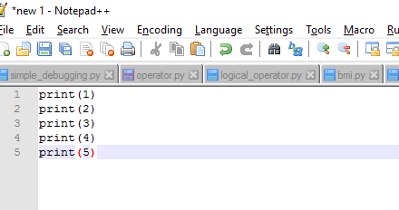
ITERATION

Slide 4
QUESTION
How would you write the code to count to 10,000?

Slide 5
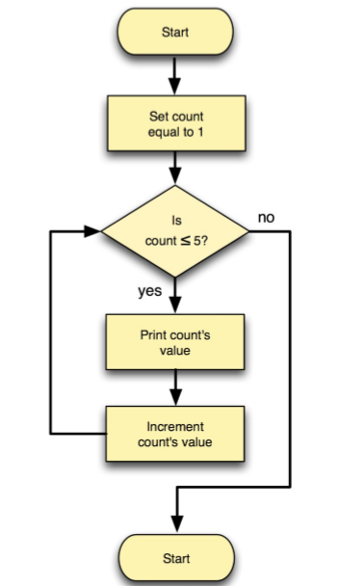
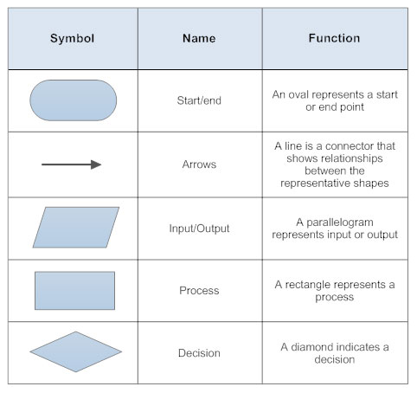
FLOWCHART
start
variable
branch
print
process
stop

Slide 6
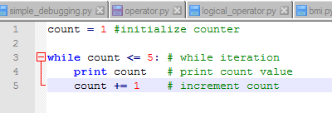
ITERATION
while condition :
block

Slide 7
TASK
Create a program that print only odd number from 1 to 100
STEP:
Loop number from 1 to 100
*Don’t forget initialize start number and end number
* Don’t forget basic math operator (+,/,-,%)
Check if the current number is odd or not
Print number if is odd and skip if is not
Increment Number

